Slide 1

Welcome to H.O.T. www.handsontech.org
Our Purpose:
Forum for interaction
Many hobbyists build/tinker in isolation
Make new friends with common tech interests
Learn together
Lots of fun new tech to explore
Share expertise, help each other
Build something
Hands-On learning
Make something fun & useful

Slide 2



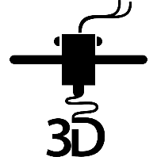
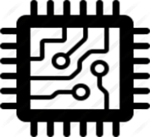
One Hands-On Tech club Two Groups
3D Printing
Small Computers

Slide 3
New to the club? Welcome!
Wondering what H.O.T. is all about?
This is a hands-on group, so we may be in the middle of a series of meetings on our way to building something interesting
Go to handsontech.org>New Members for a specially designed launching point for new members!
Please take the time to look through a few presentations at handsontech.org>Small Computers or handsontech.org>3D Printing.
Presentations are always available online after our meetings for reference and as self-paced projects

Slide 4
Club communications are via Email & Web !
To join our email list(s), fill membership form at handsontech.org>New Members
When asked for your email address, use a gmail email address if possible (we use google forums & they are picky)
You will be added automatically to our Hands-On Tech (H.O.T.) overall email list
You will also be added to the Small Computers and/or 3D Printing mailing lists and forums if you expressed interest in the membership form.
Meeting calendar is at handsontech.org

Slide 5
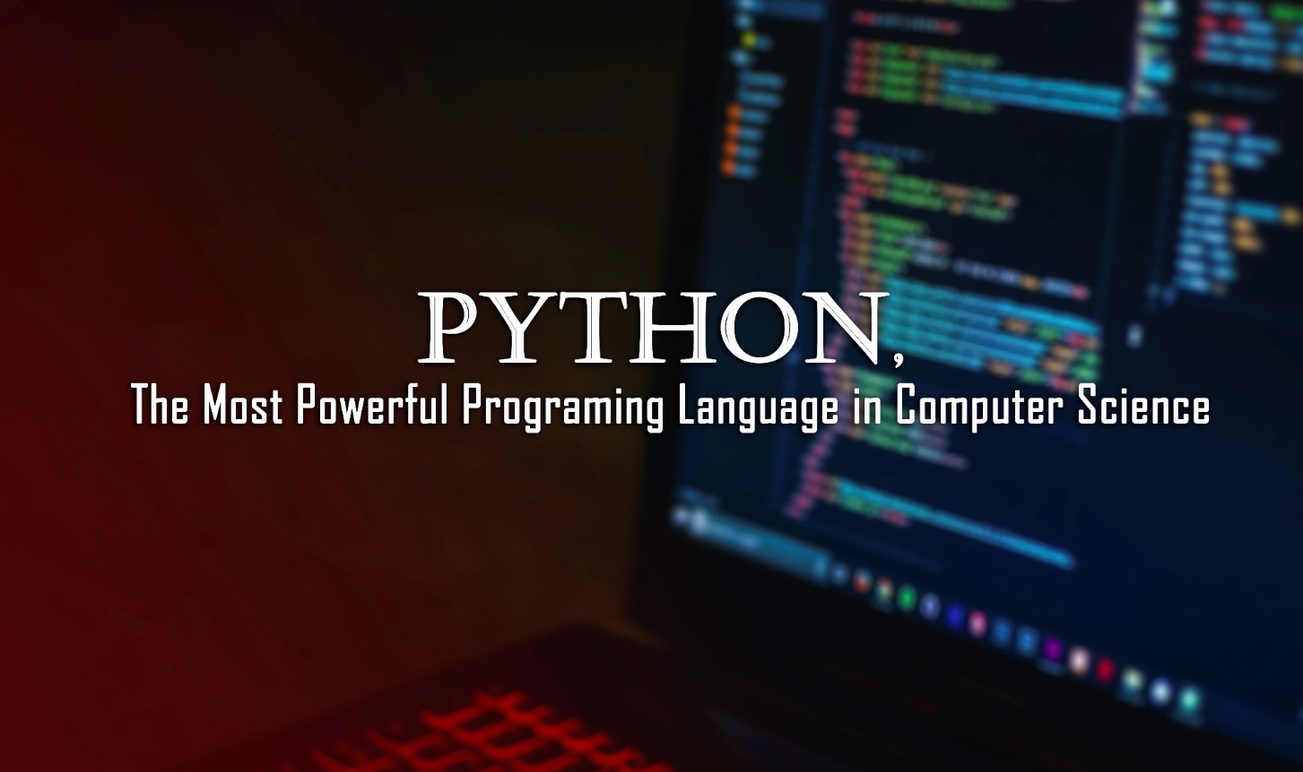
An Overview of Python & MicroPython
A Presentation for Hands On Technology Club
By Doug Blanding March 28, 2023

Slide 6
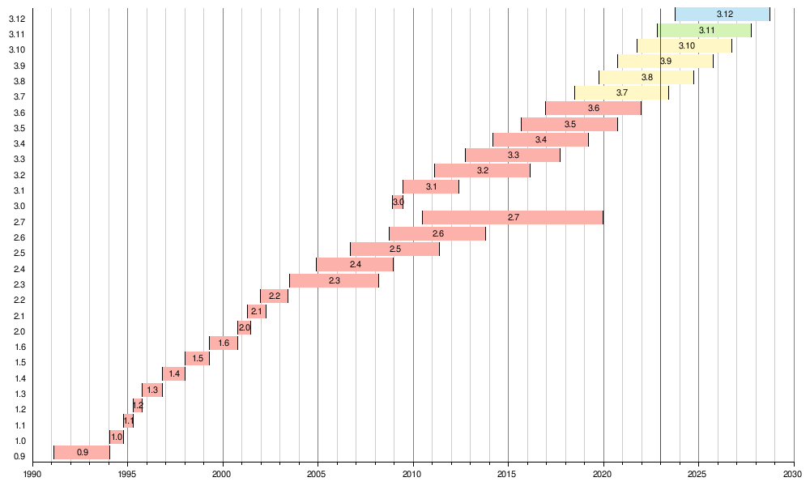
I have been using Python for almost a quarter of a century now.
In 2000, I read Mark Lutz's book Learning Python and used a project example from the book to build an online CGI website for automating the administration of a squash box-league at Kodak.
Python (then at version 1.5.2) was much smaller, but already very capable.
Since then, it has evolved through version 2 and is now at version 3.11

Slide 7
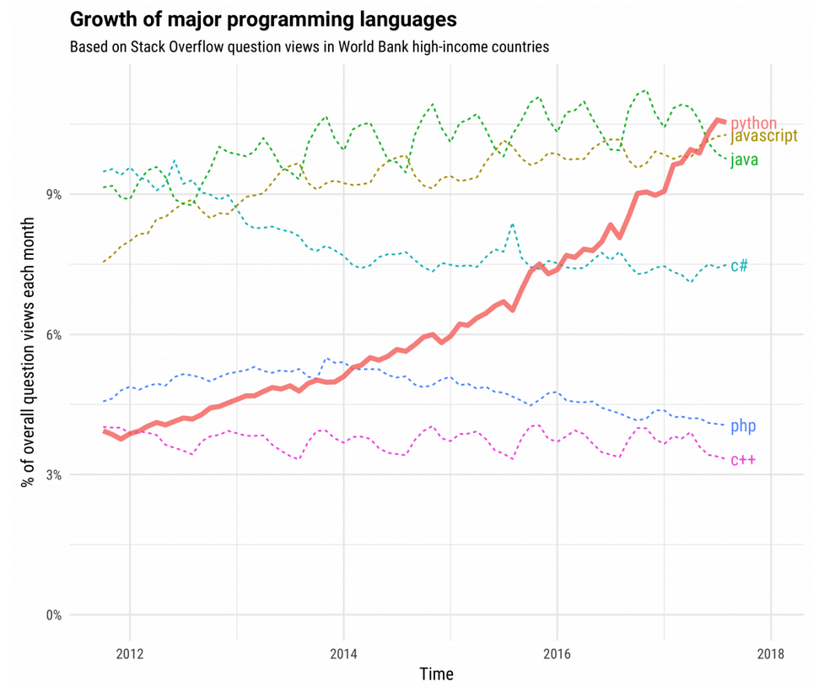
Factors contributing to Python's explosive popularity
Powerful, yet beginner friendly
High level
Easy to learn
Easy to read
Easy to write
FUN to use
Designed to have a compact core but to be highly extensible via modules.
This has enabled the creation of an immense ecosystem of libraries and extension modules

Slide 8
Python has become popular in many diverse fields of interest
* General scripting
* Hacking (both ethical and non-ethical)
* Server-side scripting language for Web Applications
* Data Science
* Scientific Computing
* AI
* Machine Learning
* 3D graphics
* Computer vision
* Games
* Natural language processing

Slide 9
Designed as a high-level programming language
* having a strong abstraction from the details of the computer
* uses natural language elements, making it more intuitive and easy to use
* uses indentation to define code blocks
* automates or hides low-level details of the hardware interface
* e.g.: memory management
* Allocation
* Deallocation (automatic garbage collection)
* the stack
* the heap
* Dynamically typed

Slide 10
Python Supports multiple programming paradigms * Object-oriented programming (OOP) * Structured programming * Functional programming

Slide 11
Structured programming
A programming paradigm aimed at improving the clarity, quality, and development time of a computer program by making extensive use of the structured control flow constructs of selection (if/then/else) and repetition (while and for), block structures, and subroutines.

Slide 12
Functional programming
A programming paradigm where programs are constructed by applying and composing functions. It is a declarative programming paradigm in which function definitions are trees of expressions that map values to other values, rather than a sequence of imperative statements which update the running state of the program.

Slide 13
Object-oriented programming (OOP)
A programming paradigm based on the concept of "objects", which can contain data and code. The data is in the form of fields (often known as attributes or properties), and the code is in the form of procedures (often known as methods)

Slide 14
* Python is a general-purpose programming language that can be extended by importing modules * Python code is an interpreted language, (as opposed to a compiled language)

Slide 15
What does it mean for a language to be Interpreted vs Compiled?

Slide 16
In a compiled language:
* Source code must be converted (compiled) into machine code so that it can be executed by the processor.
* This machine code will run **only** on the target device for which it was compiled.
* Windows, MacOS, Linux, etc.
* Once compiled, the code can run very fast.
* Ideal for a device with limited resources because the machine code runs directly on the CPU.
In an interpreted language:
* Source code instructions are read and executed sequentially at run time.
* A significant advantage of an interpreted language is that it does not have to be compiled for each hardware target separately.
* A disadvantage is that interpreted code does not run as fast as compiled code.
* A Python interpreter is available for pretty much every computer operating system.
* But until recently, the interpreter is too big to fit on a microcontroller.

Slide 17
What languages can be used to program a Microcontroller?
* Because of the limited resources (processor speed, ROM, RAM) available on a microcontroller, a **compiled** language (such as C) has long been the obvious choice. For Arduino, the one obvious choice is **C for Arduino**.
* A full-fledged Python3 interpreter (CPython) is too big to fit on a microcontroller. So the developers have created a special version of Python with stripped-down libraries that will fit on a microcontroller. This is known as MicroPython (Python for Microcontrollers).
* MicroPython, has been written in C to be compatible with Python version 3.4 but has been optimized to run on a microcontroller. It consists of a Python compiler to bytecode and a runtime interpreter of that bytecode. It includes a selection of core Python libraries plus some modules which give the programmer access to low-level hardware of the microcontroller.

Slide 18

The Topology of the MicroPython configuration
Last month at FOSDEM'23, Wouter van Ooijen presented an excellent talk A Quick Introduction to MicroPython https://ftp.osuosl.org/pub/fosdem/2023/UD2.218A/python_micropython_intro.mp4

Slide 19
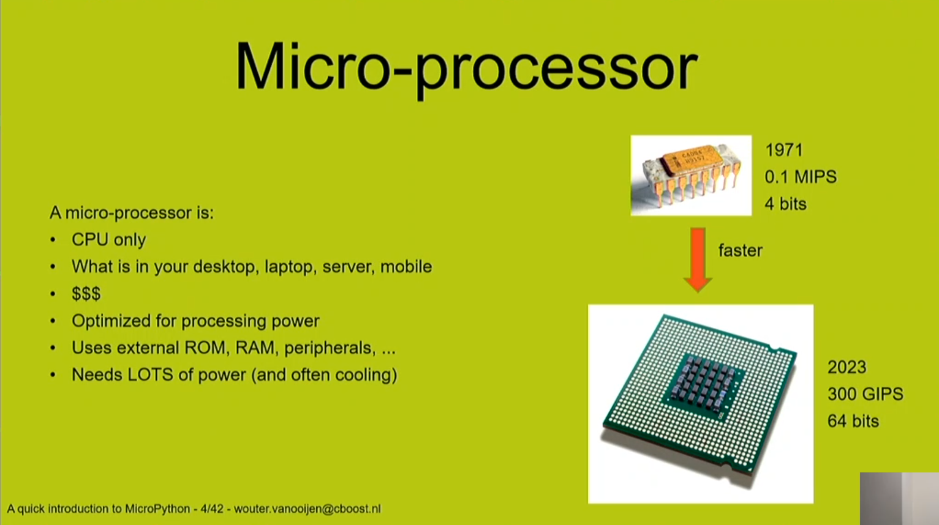
Some Terminology

Slide 20
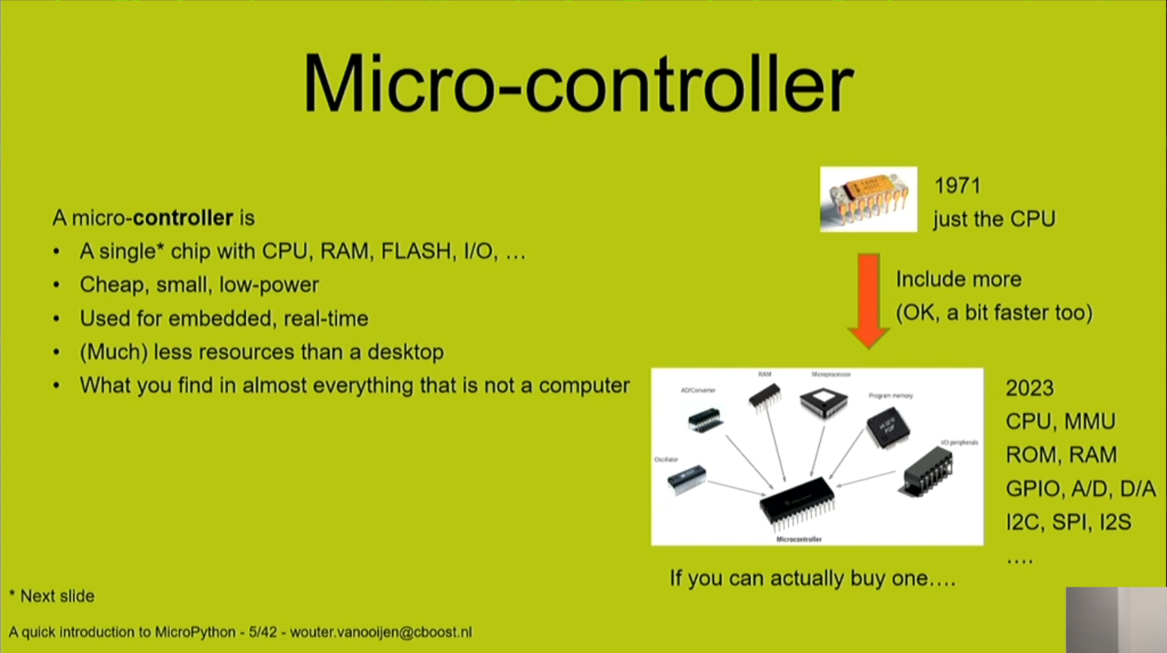
A modern Microcontroller is almost like a ‘bare-bones’ computer

Slide 21
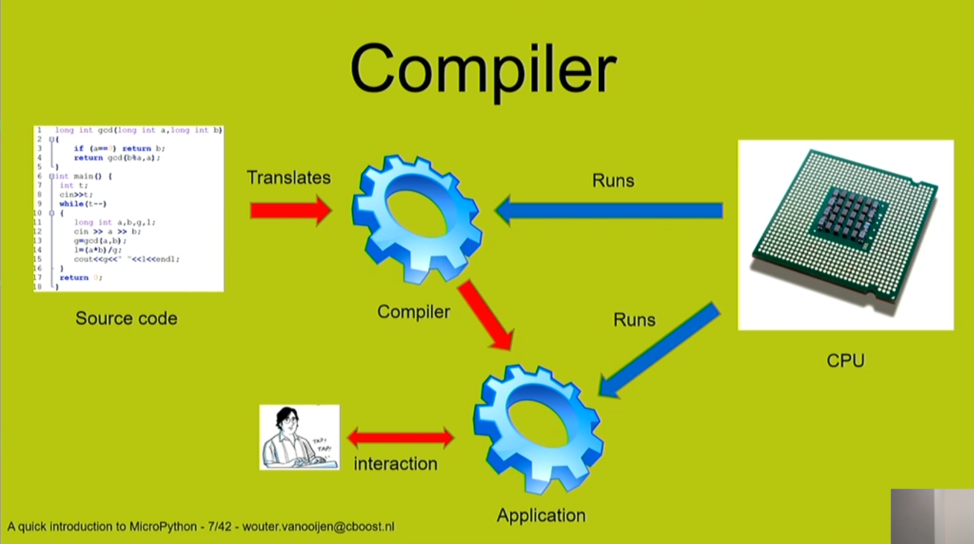
Compiler topology

Slide 22
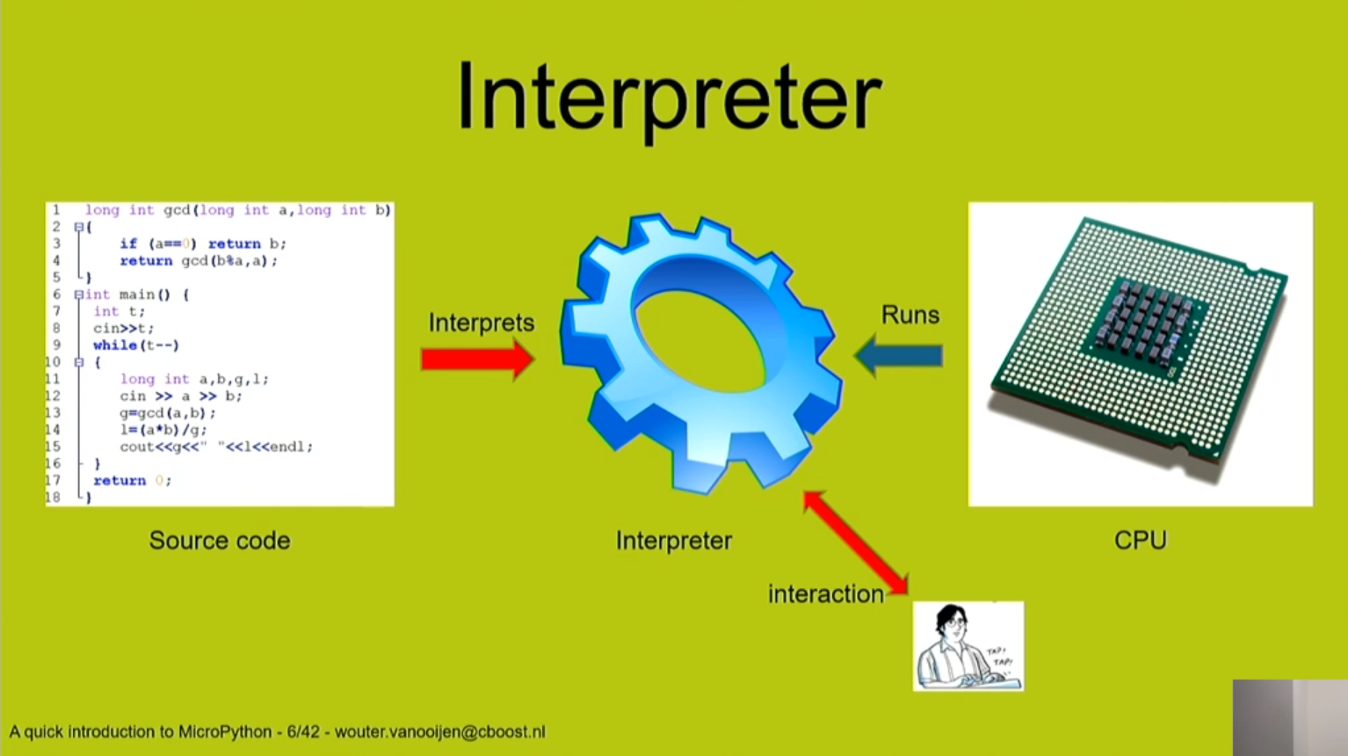
Interpreter topology

Slide 23
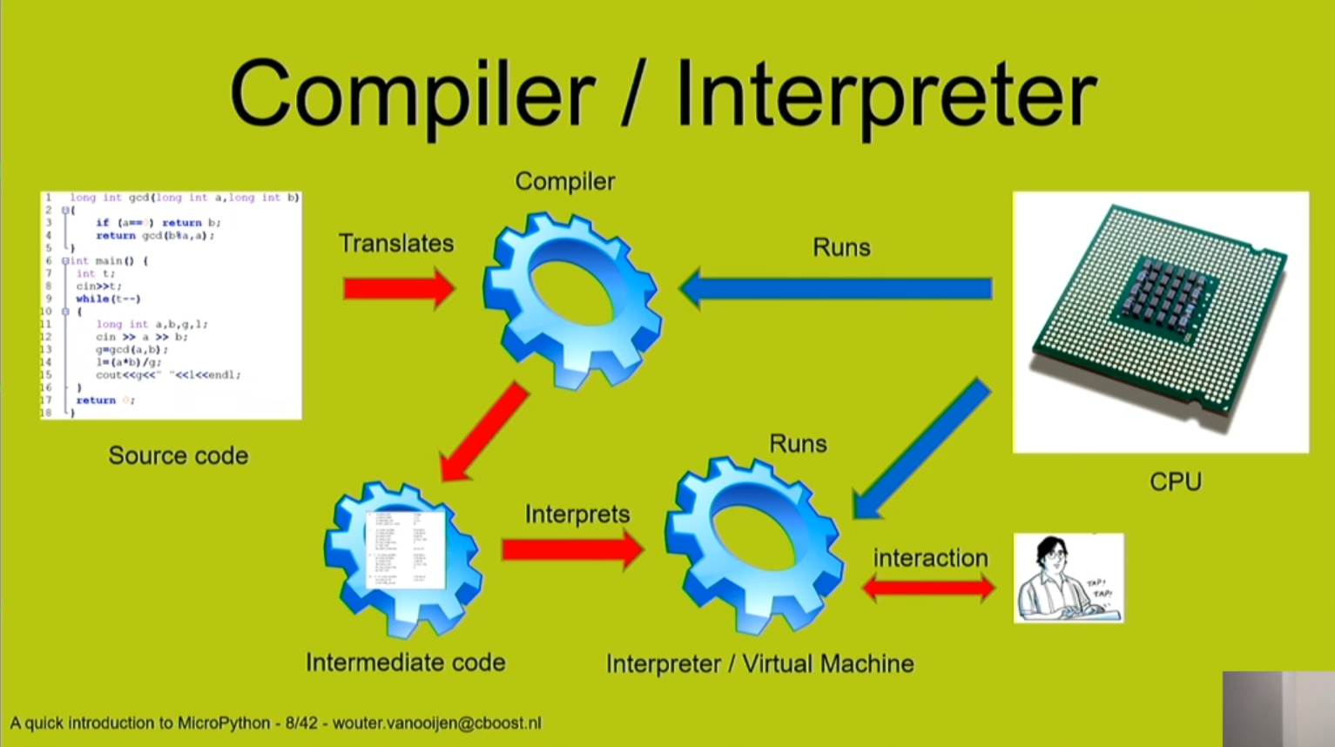
Python code is first pre-compiled to byte-code, which is then fed to the CPU

Slide 24
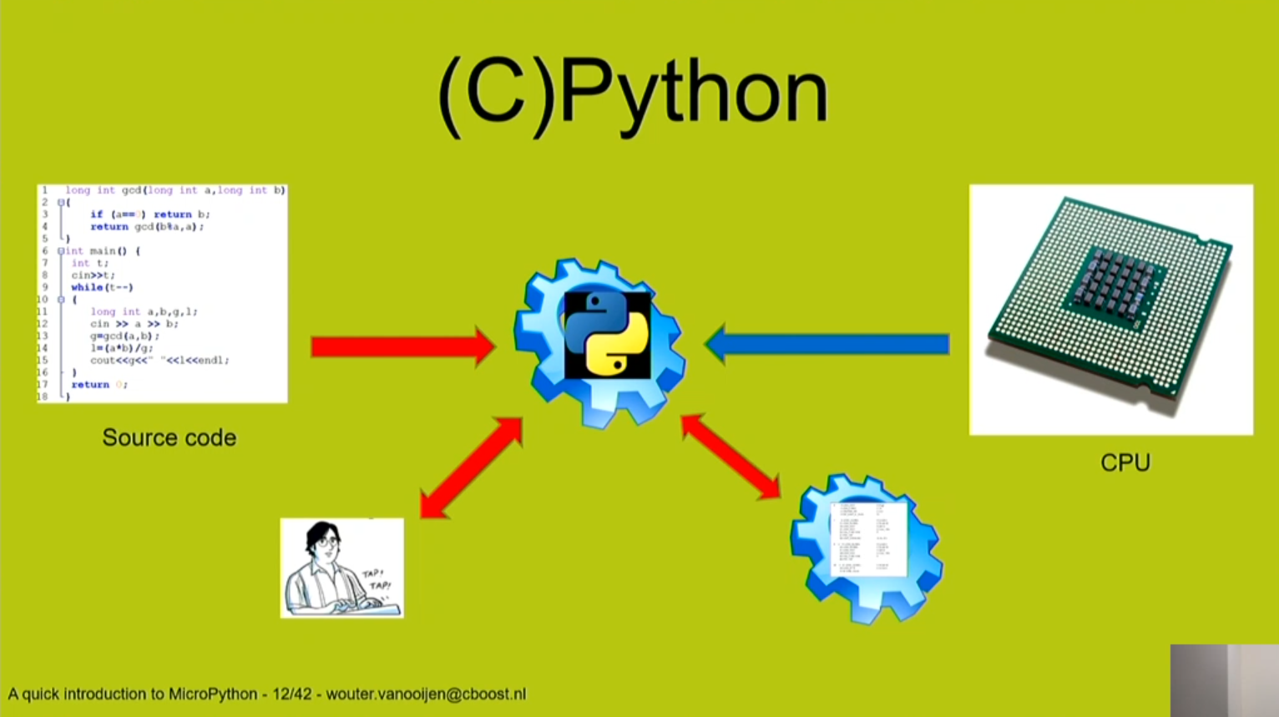
This is how you work with Python on your laptop computer

Slide 25
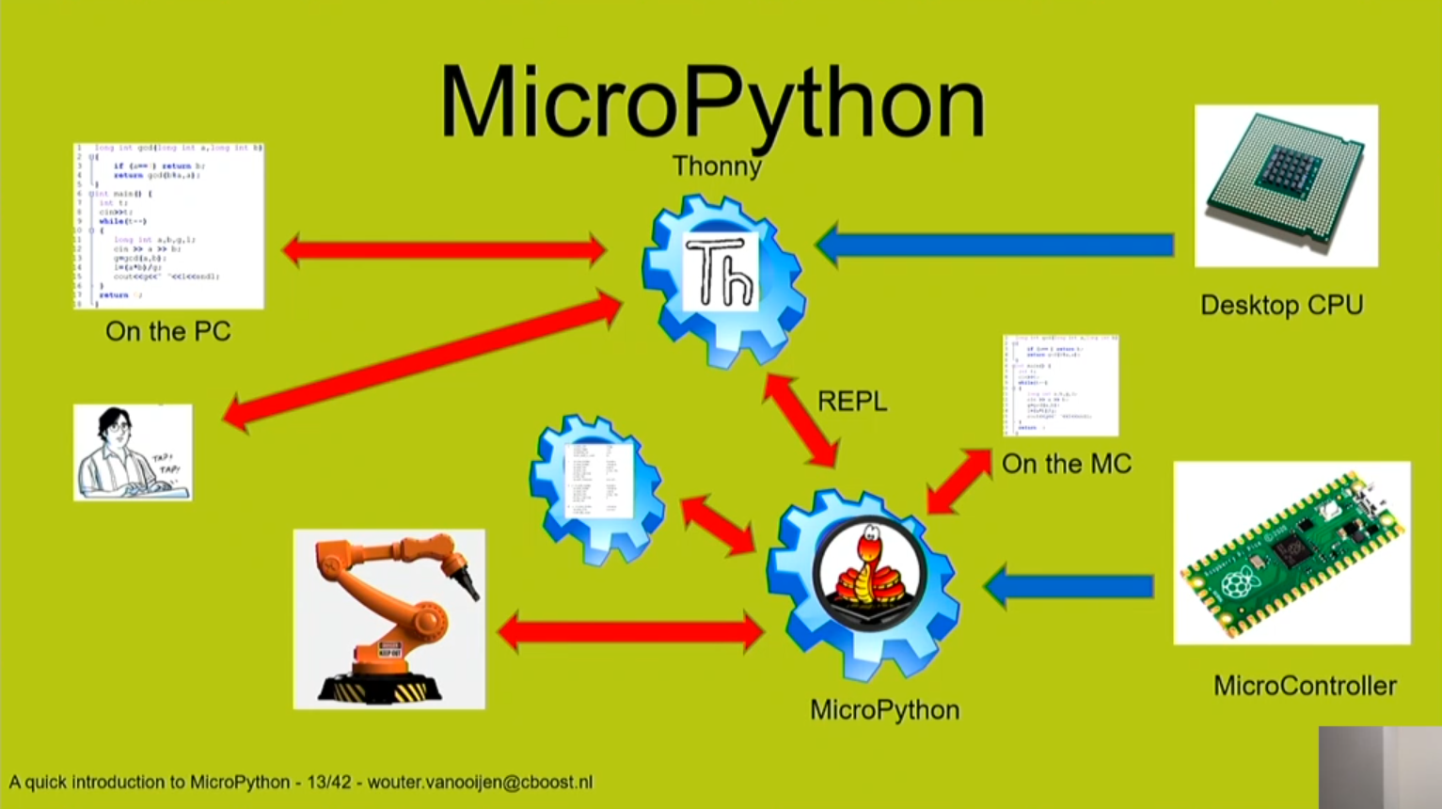
This is how you work with MicroPython on a RasPi Pico microcontroller board

Slide 26
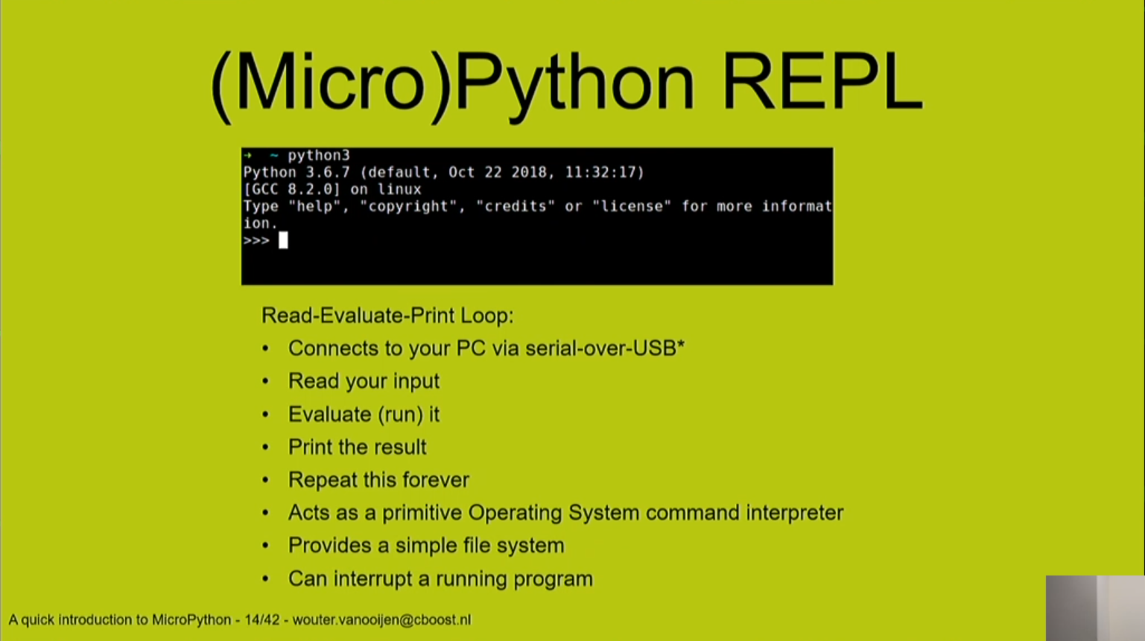
The interactive REPL

Slide 27
How does MicroPython compare with Python?
MicroPython has same syntax and coding style as full Python
MicroPython implements Python 3.4 and some select features of Python 3.5 and above (https://docs.micropython.org/en/latest/genrst/index.html)
CPython is designed to run on larger and more powerful processors such as a desktop or a laptop computer. MicroPython is designed to run on smaller, cheaper, and low power microcontrollers such as PyBoards, Raspberry Pi Boards, and Arduino Boards.
MicroPython is a *stripped-down* version of full Python
Whereas Python has hundreds of thousands of libraries, these are not available for use by MicroPython.
Instead, the MicroPython developers have created a set of special *light-weight* libraries (many having a `*.upy` file extension) for use on devices with limited resources.

Slide 28
What is CircuitPython?
CircuitPython is a derivative of MicroPython, developed by Adafruit
Intended to emphasize and facilitate the learning process. Their goal:
Beginner Friendly
Quick and Easy
Provide online support for questions related to their boards.
Similar to MicroPython, the developers have created a set of special *light-weight* libraries (with a `*.mpy` file extension) that work with CircuitPython
The Adafruit website provides detailed 'How-To' instructions that accompany each of their boards.
Detailed instructions for loading the latest version of CircuitPython
The available libraries for each board are different, depending on the capabilities of the particular board.
Detailed example projects are presented, along with *Project bundles* for download

Slide 29
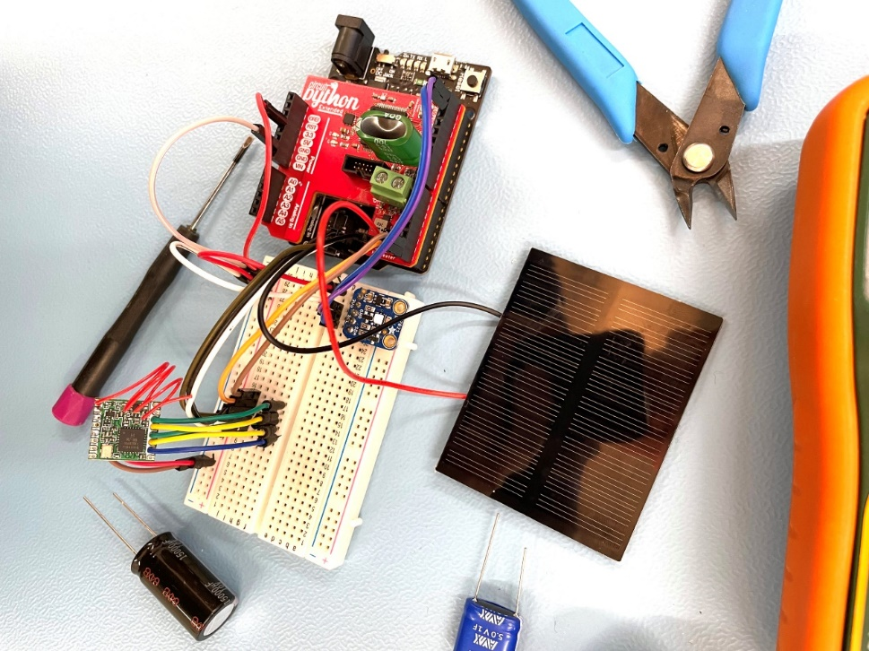
My personal segue into MicroPython
Gerald Swan sent an email about this Perpetual Battery-Free Weather Station project that piqued my curiosity:
CircuitPython (Adafruit Metro M0 Express)
LoRa
Custom Circuit board
Time Required: 1–3 Hours
Difficulty: Easy
Price: $0-$50
Battery free using
Solar cell & superCapacitor
Perpetual Battery-Free Weather Station project https://makezine.com/projects/perpetual-battery-free-weather-station/

Slide 30
I jumped in and started ordering parts
I ordered the Metro, the solar cells, the circuit board and supercapacitors.
Then I found myself looking online for tutorials on how to solder 80 pin surface mount microcontrollers
That was when I realized that this project was not going to be even close to EASY & CHEAP.
So I decided to SCRAP this project
But I can still play with the Metro and learn CircuitPython
Leading to a couple of potential projects:
Grandfather clock regulator
Controller for carriage lights

Slide 31
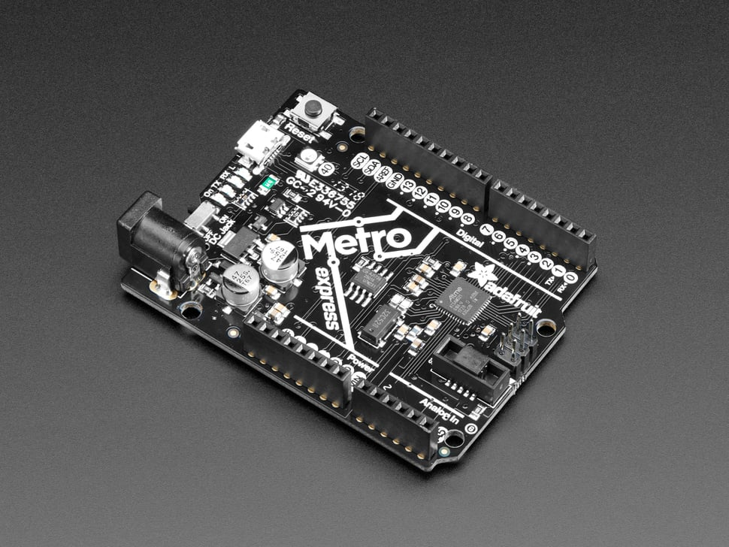
How I got started w/ CircuitPython
Project to regulate the speed of my Grandfather Clock
Use the Adafruit Metro M0 Express
‘Arduino Uno’ size & shape
Installed CircuitPython on the M0
Installed the Mu editor on my laptop
Metro doesn’t have WiFi support
but I don't really need this.
Metro doesn't have a real time clock
so I added an Adafruit PCF8523 RTC
The clock regulator project works!
But now I want to get WiFi working in order to do other projects!

Slide 32
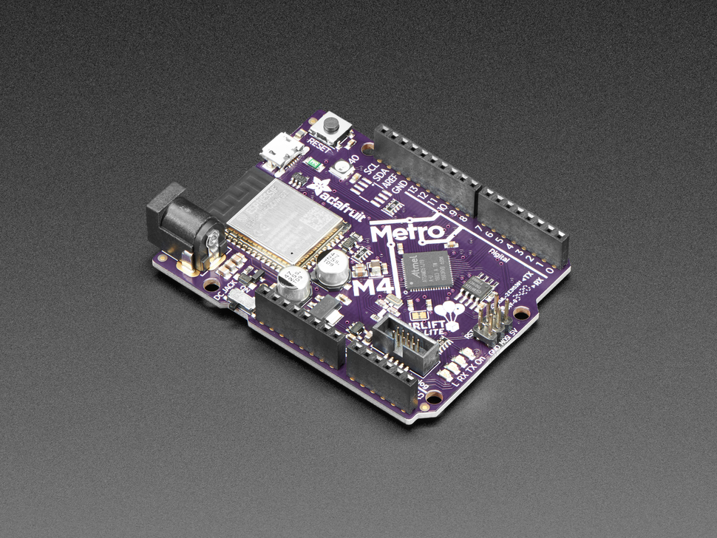
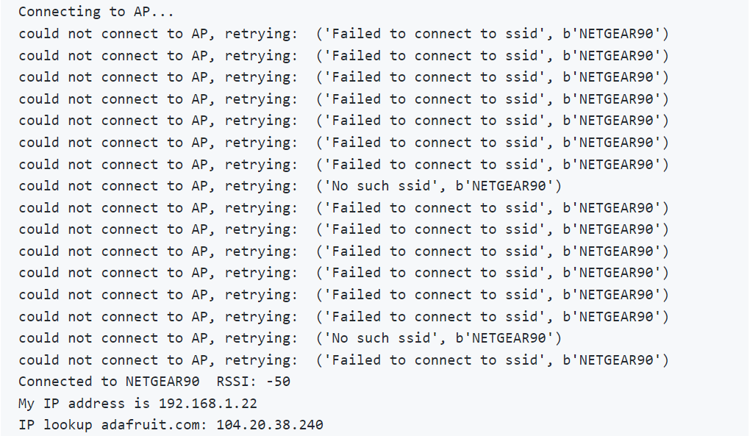
Got the M4 ‘Airlift’ to enable WiFi connection
But its WiFi performance was disappointing

Slide 33
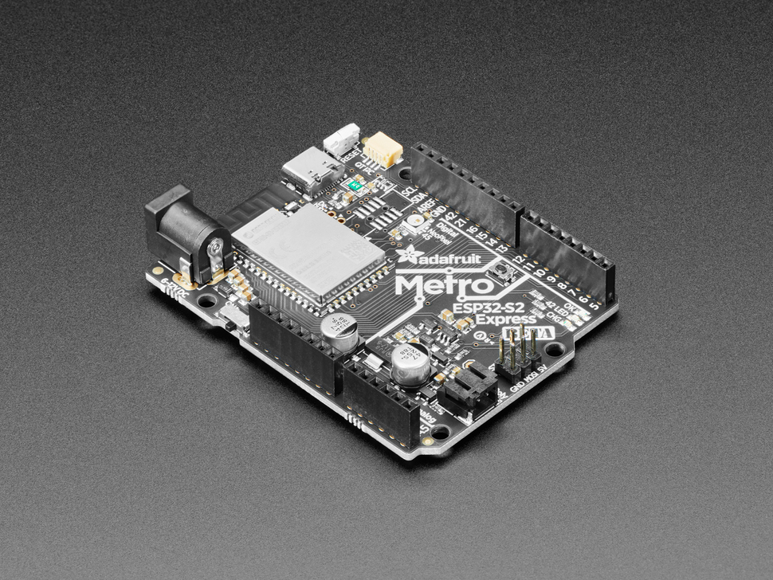
Got the Metro ESP32-S2 Express
Loading CircuitPython is a bit more complicated than it was on the M0 & M4
Uses C-type USB rather than micro-USB
Connects well to WiFi
Has its own RTC
Lots of pre-loaded modules

Slide 34
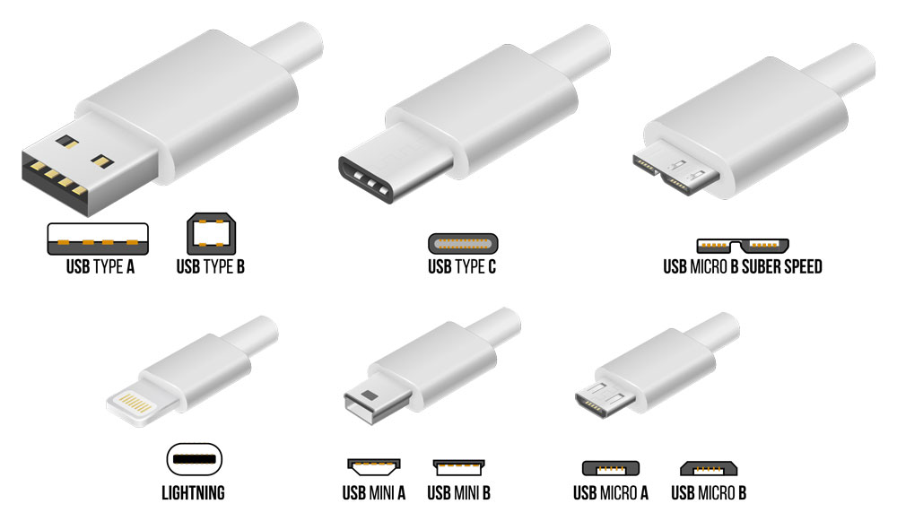
Variety of USB connector types

Slide 35
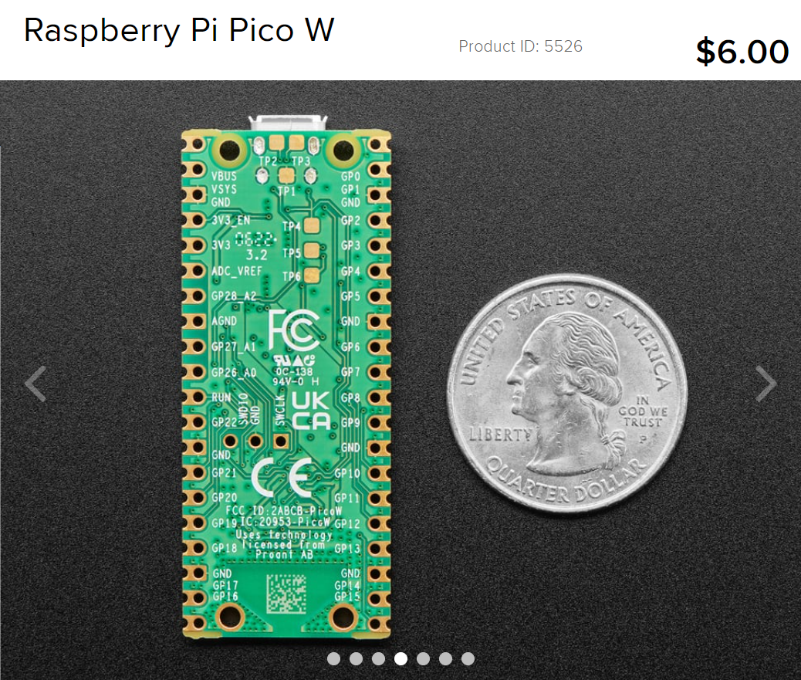
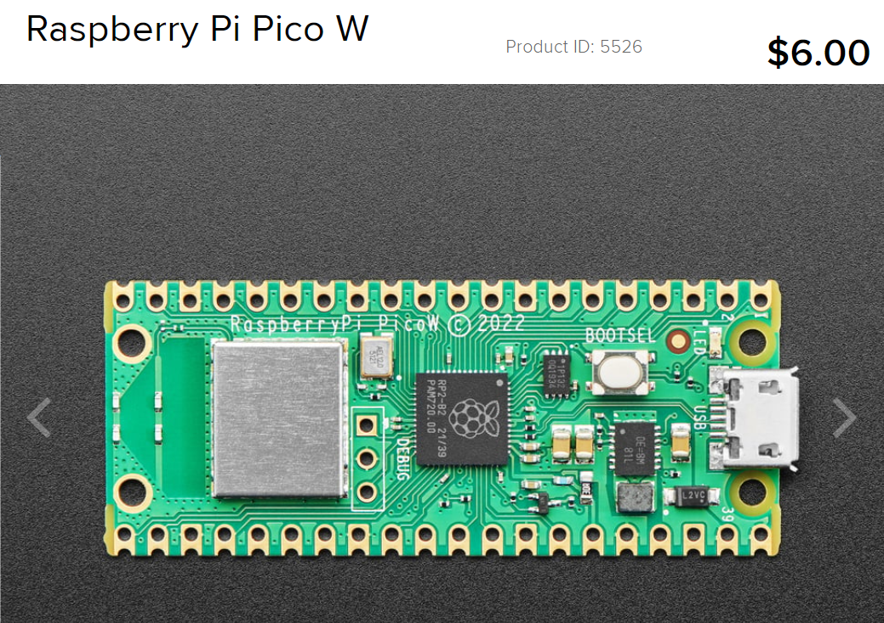
Raspberry Pi Pico W
At this point, I discovered the Raspberry Pi Pico W with MicroPython.

Slide 36
Install MicroPython on Raspberry Pi Pico-W
Install Thonny
* $ `pip install thonny`
* Now Thonny can be started from normal terminal
* $ `thonny`
* Drag & Drop installation of MicroPython onto Pico is a breeze!

Slide 37

Drag & Drop installation of MicroPython

Slide 38
Drag & Drop installation of MicroPython
The animated GIF on the previous slide is a little misleading. The URL from which you download the uf2 file (in step 1 above) is located at the website linked to by clicking on `INDEX.HTM` (shown in step 3). Once you have downloaded that file, you just drag and drop it into the 'RPI-RP2’ folder.
STEP 1 Mount the new Pico on your computer’s filesystem.
Press and hold the 'BOOTSEL' button
Plug in the USB cable
Release the 'BOOTSEL' button
'RPI-RP2' now shows up mounted in the host computer's filesystem
STEP 2 Open ‘INDEX.HTM’, navigate to .UF2 file, download it
STEP 3 Drag & Drop the .UF2 file into the 'RPI-RP2' folder

Slide 39
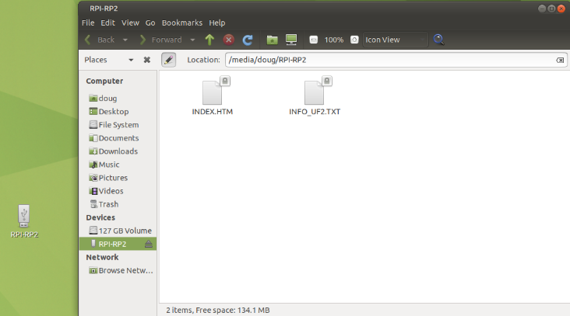
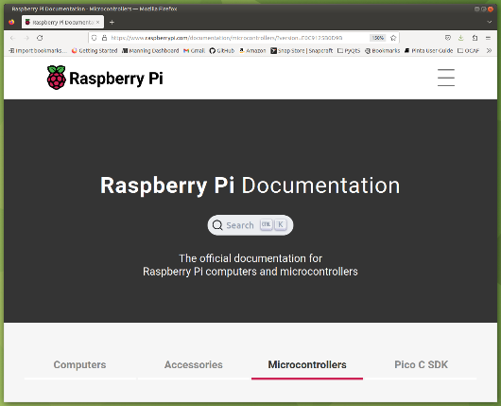
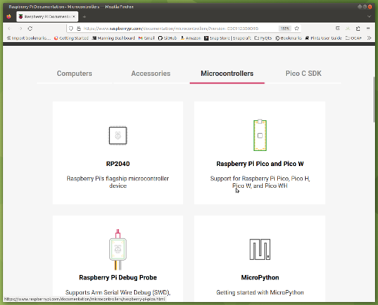
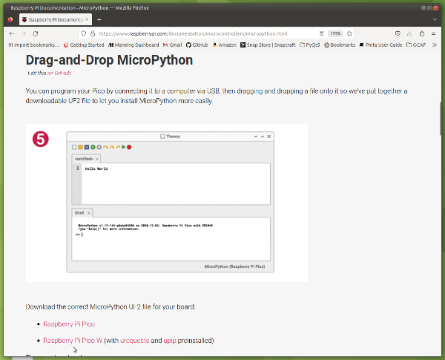
Installation Steps
After plugging in the USB with BOOTSEL pressed
RPI-RP2 folder shows up on Desktop
Click to open INDEX.HTM
This opens up ‘Raspberry Pi Documentation’ page
Scroll down
Click on ‘MicroPython’
Click on Raspberry Pi Pico W to download latest .uf2 file
Drag and drop this file into RPI-RP2 folder
The RPI-RP2 folder will disappear
The Pico is now available as device /dev/ttyACM0

Slide 40
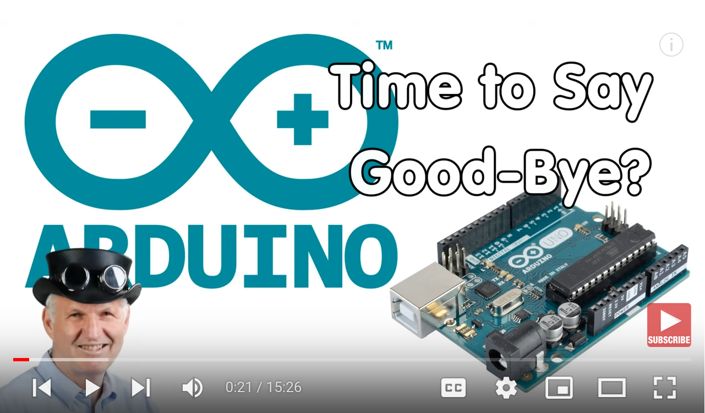
MicroPython is poised to compete with Arduino
Python seems to be the fastest growing programming language. It is also widely used to program Raspberry Pis, and it is on the verge to become available on our small microcontrollers. Has the time come to leave the Arduino IDE and go on? Time for a closer look.
#240 Time to Say Goodbye to Arduino and Go On to Micropython / Adafruit Circuitpython? https://www.youtube.com/watch?v=m1miwCJtxeM&list=RDCMUCu7_D0o48KbfhpEohoP7YSQ&index=12

Slide 41
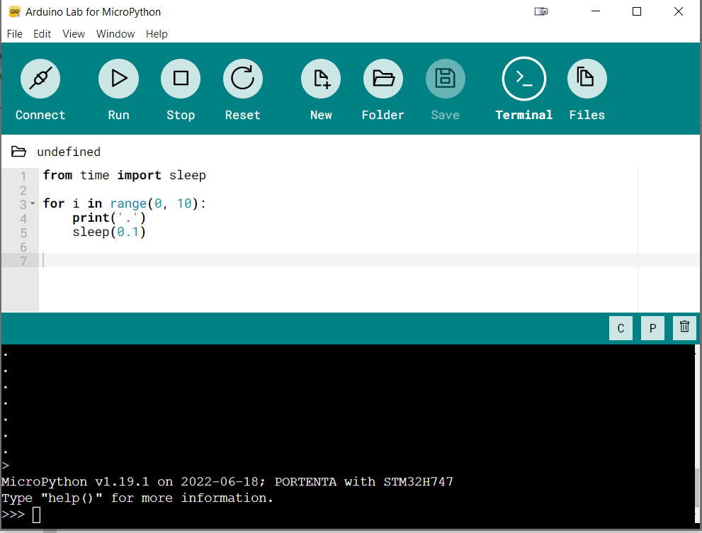
Arduino embraces MicroPython
So, it finally happened that MicroPython eventually became a part of the Arduino ecosystem. The Arduino team recently announced that it is bringing in the microcontroller-focused Python into a number of its products, making Micropython the second officially-supported language in the history of the company. This is such a big move for Arduino which for a long time had focused only on C/C++ programming languages.
Arduino Announces Support for MicroPython, Brings it to Several of its Development Boards https://www.electronics-lab.com/arduino-announces-support-for-micropython-brings-it-to-several-of-its-development-boards/

Slide 42
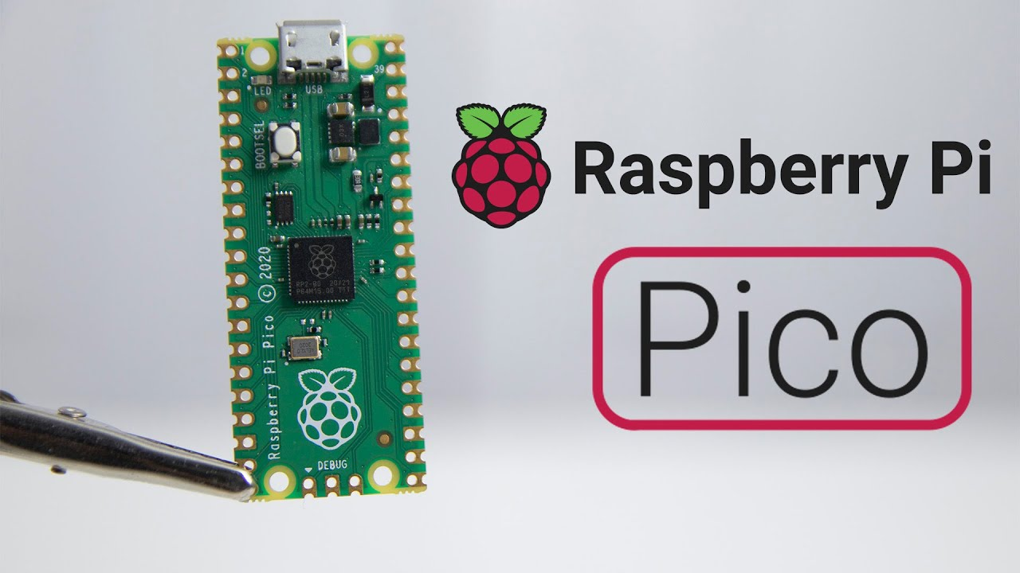
Raspberry Pi introduces the Pico and the Pico W
Today, we woke up to some very interesting news. The Raspberry Pi foundation is finally taking their first steps in Arduino territory! Well, not quite, as they are more working together than rivaling each other. After both companies dominate the maker market with their widely popular, easy to use boards that the community loves, the Raspberry Pi Pico comes in, a blazing fast and peripheral-rich microcontroller, based on the brand new RP2040 chip.
Raspberry Pi Dives Into The Microcontroller World With The New Raspberry Pi Pico https://www.electronics-lab.com/raspberry-pi-dives-into-the-microcontroller-world-with-the-new-raspberry-pi-pico/

Slide 43
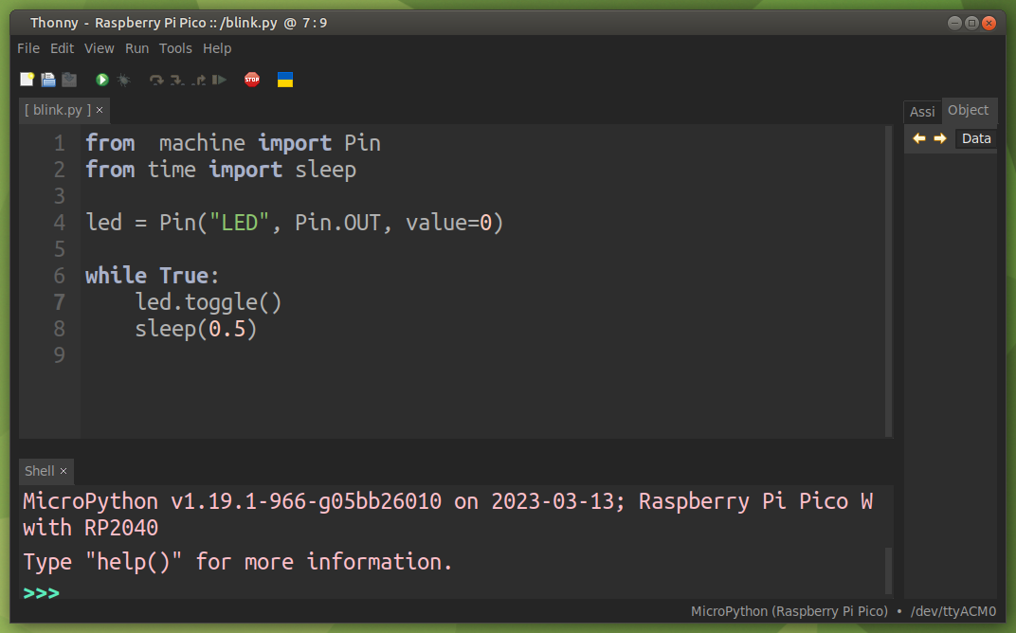
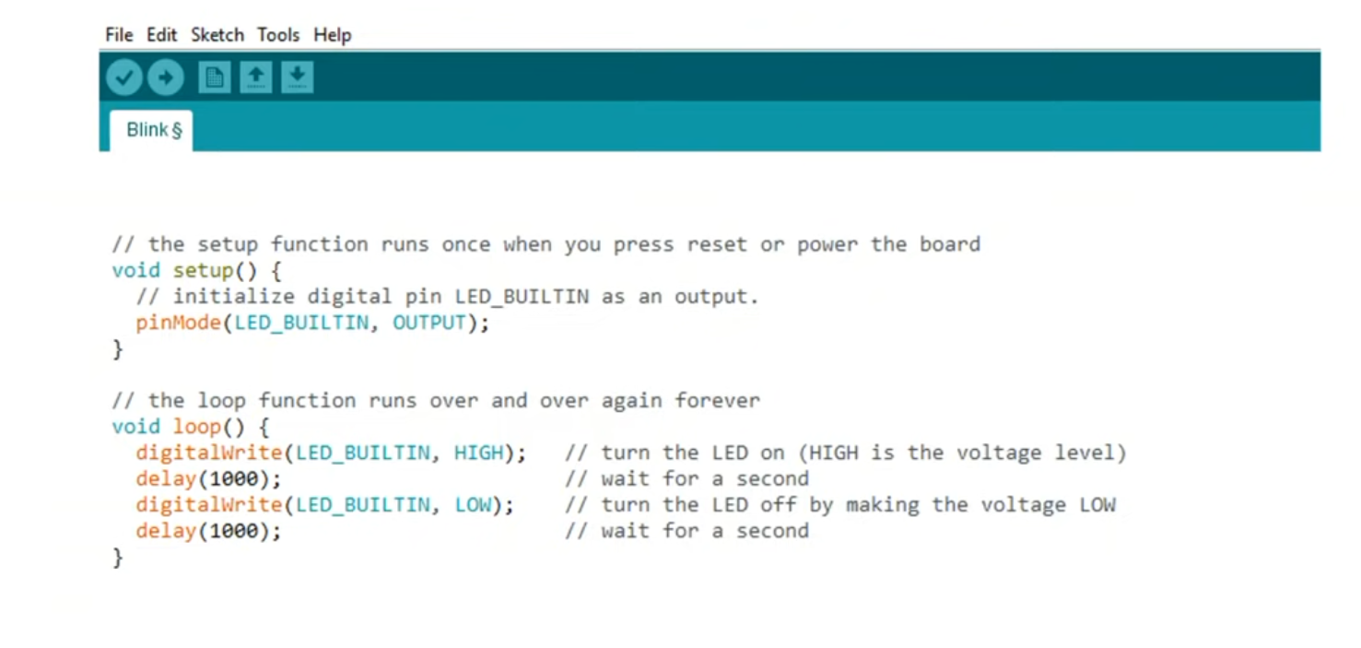
Code Comparison: Blink
Arduino
MicroPython

Slide 44
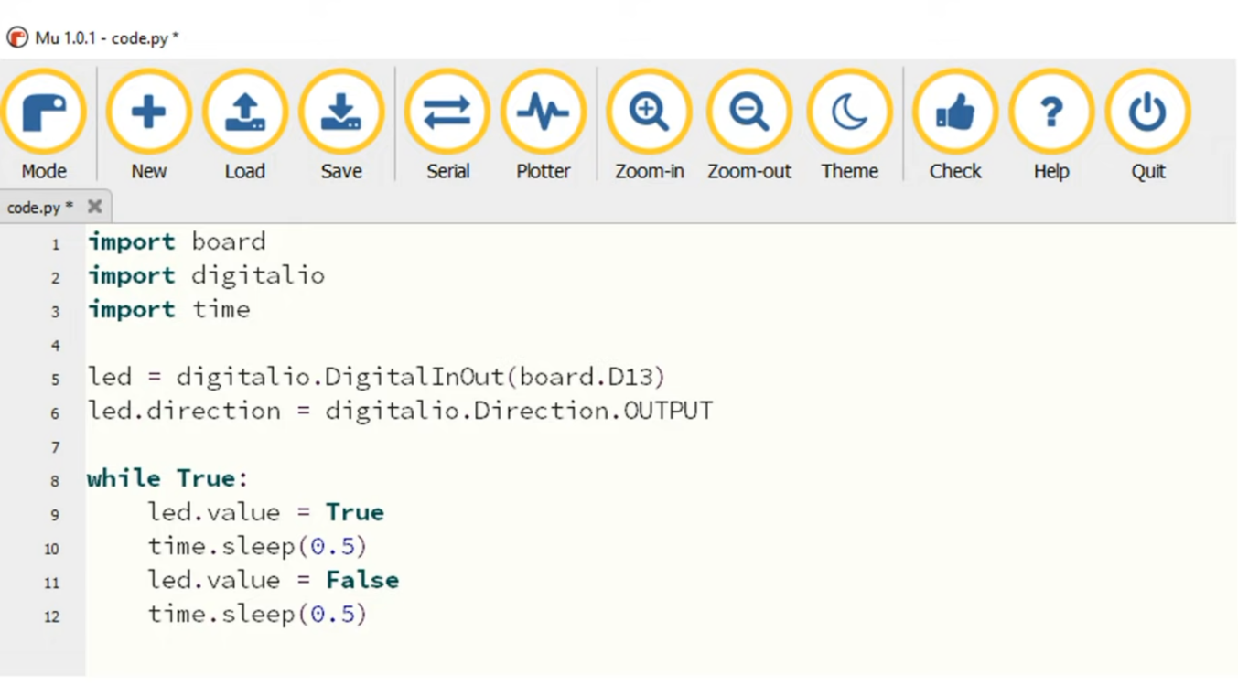
Code Comparison: Blink
CircuitPython
MicroPython
Uses Mu editor
Uses Thonny IDE

Slide 45

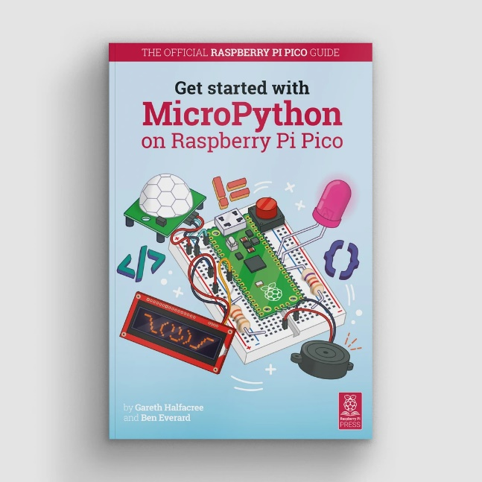
How to get started with Python
Reuven Lerner’s free online course
Python for Non-Programmers
https://store.lerner.co.il/python-for-non-programmers-live
Eric Matthes’ Python Crash Course
Dive right in with The Official Raspberry Pi Pico Guide

Slide 46
Some Relevant Links
Video (55 min) presented at FOSDEM '23 An Introduction to MicroPython https://ftp.osuosl.org/pub/fosdem/2023/UD2.218A/python_micropython_intro.mp4
Random Nerd Tutorials Getting Started with Thonny MicroPython (Python) IDE for ESP32 and ESP8266 https://randomnerdtutorials.com/?s=flash+firmware+onto+8266
Sonoff DIY Smart Switch Project https://drive.google.com/file/d/1whJVSwAy5lDRt20VTkXW4LZ6KZNcHsqH/view
What is the difference between Python and MicroPython? https://www.educative.io/answers/what-is-the-difference-between-python-and-micropython
MicroPython vs Python https://linuxhint.com/micropython-vs-python-comparison/

Slide 47
More Relevant Links
Video: CircuitPython vs Micropython https://core-electronics.com.au/videos/circuitpython-vs-micropython-key-differences
Video: Basic Comparison Between MicroPython and Arduino https://www.youtube.com/watch?v=4eL5tQLDE2o
Official MicroPython Website https://micropython.org/
Official pyboard https://store.micropython.org/pyb-features
Video Most Popular Programming Languages https://statisticsanddata.org/data/the-most-popular-programming-languages-1965-2022-new-update/
Asked on CircuitPython Forum if there is a library to send emails https://forums.adafruit.com/viewtopic.php?p=963132#p963132 like uMail in MicroPython

Slide 48
Links relating to MicroPython and Pico
[The official documentation for Raspberry Pi computers and microcontrollers] (https://www.raspberrypi.com/documentation/microcontrollers/?version=E0C9125B0D9B)
[Connecting to the Internet with Raspberry Pi Pico W] (https://datasheets.raspberrypi.com/picow/connecting-to-the-internet-with-pico-w.pdf)
[Official MicroPython documentation (for the RP2)] (https://docs.micropython.org/en/latest/rp2/general.html)
Kevin McAleer video [Micropython Threads - Use Both Cores, on Raspberry Pi Pico and ESP32] (https://www.youtube.com/watch?v=QeDnjcdGrpY)
[Development Boards / MicroPython](https://www.adafruit.com/category/924)

Slide 49
More Links relating to MicroPython and Pico
Andreas Spiess video #240 Time to Say Good-Bye (to Arduino) https://www.youtube.com/watch?v=m1miwCJtxeM&list=RDCMUCu7_D0o48KbfhpEohoP7YSQ&index=11
Andreas Spiess video #370 Pi Pico vs Competition https://www.youtube.com/watch?v=cVHCllbN3bQ
Andreas Spiess video #372 How to use the two Cores of the Pi Pico? And how fast are Interrupts? https://www.youtube.com/watch?v=9vvobRfFOwk
Drone Bot Workshop CircuitPython with Raspberry Pi Pico https://www.youtube.com/watch?v=07vG-_CcDG0
Video: Multi Thread Coding on the Raspberry Pi Pico in MicroPython https://www.youtube.com/watch?v=1q0EaTkztIs
Associated code on GitHub repo https://github.com/getis/pi-pico-spi-lcd-ili9341-st7789

